Slide 1
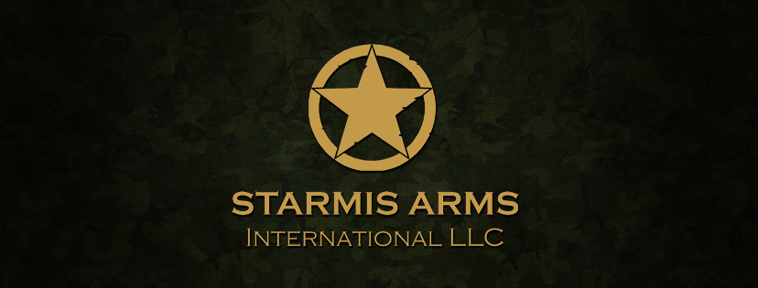

Slide 2
Starmis arms International
* Stramis Arms International is a Florida based Military Arms & Equipment supplier company.
* Our mission is to become yours all in one supplier for all Military & Law Enforcement demands.
* One of our main business is manufacturing weapons such as pistols, Assault Rifles & long
distance Sniper Rifles and specialized Ammunition .
* As a fully licensed company we have a lot more capabilities in supplying a massive verity of
Military Arms such as: Drones, missiles, helicopters, Standard Ammunition & high end
Ammunition, Explosives, Intelligence and sophisticated systems, bomb disposal, Artillery.
* Our first and most important ability to is supply our clients demands even if it looks as an
impossible mission.
* Among our clients there are a lot of countries that we where the only company managed to
provide their needs.
* Proof of our success is that we keep and hold our ongoing business relations for long period of time.

Slide 3
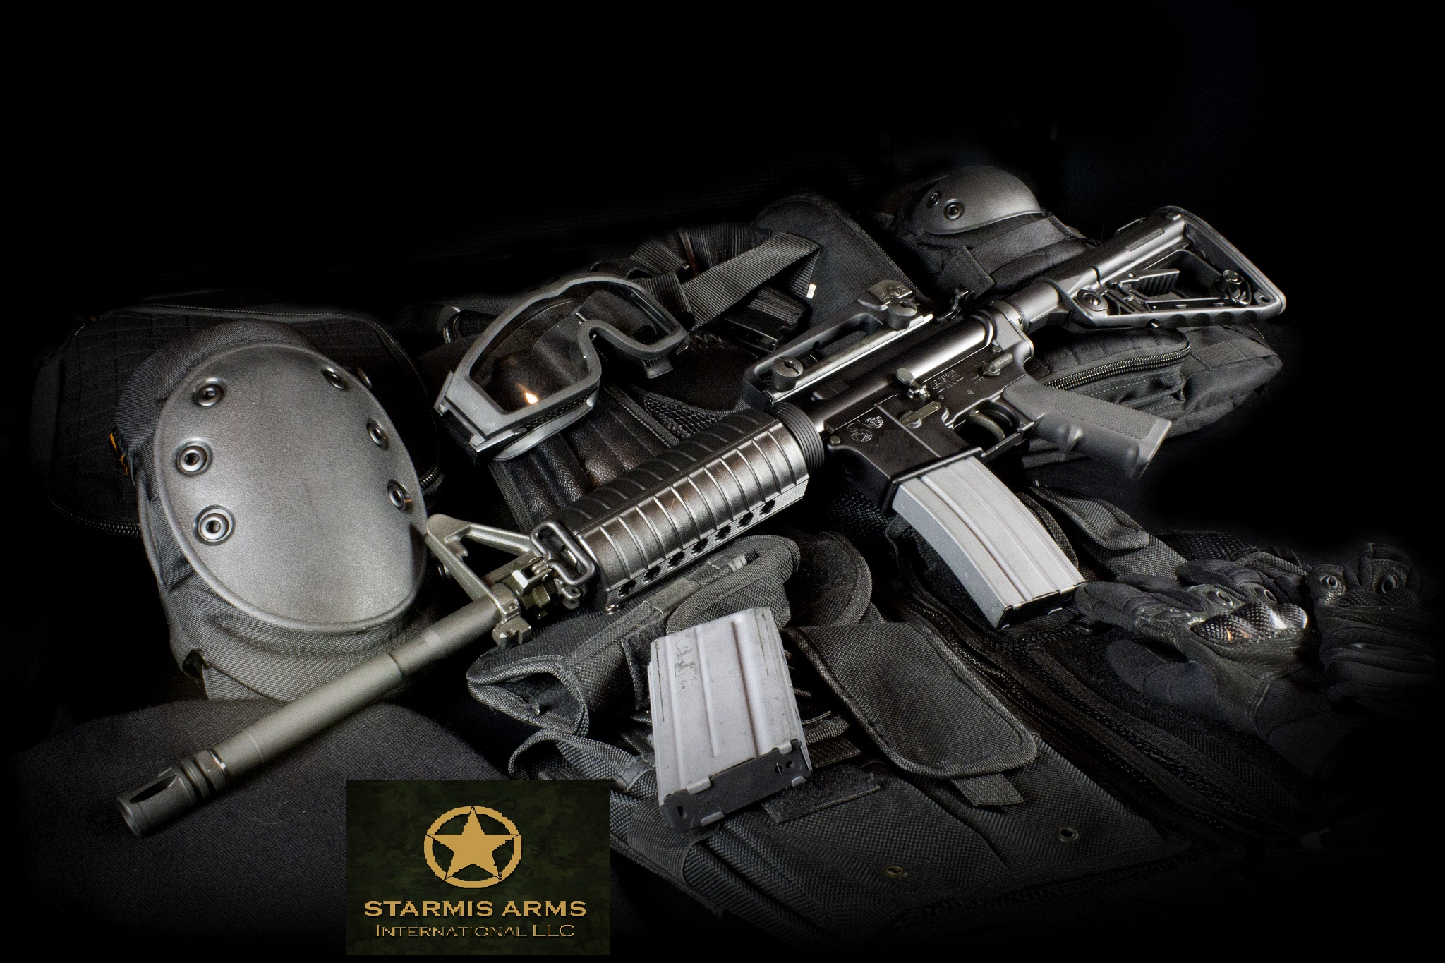
Assault Rifles
The BEAST Series.
Our BEAST ‘S are the most advanced most high end proven combat Rifles out there in the market.
It’s a M4 platform Rifle well build extremely durable at a high end quality that chambered to: 762*39 round.
At over of 800 RPM its one of the best rifles in the world today.
The BEATS also comes in a variety of Barrel Lengths, Grips, Colors Etc.
The BEAST also comes chambered in 5.56 NATO / 300 Blackout / 338 Lapua, 308 Win. if requested.

Slide 4
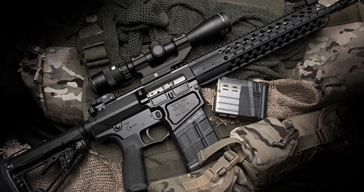
The levi series
The Levi system is a AR platform that
chambers the large .308 rounds (762X51).
The rifle can also come is a 338 round (762X54) which makes it a very unique system that can provide you with a Sniper Rifle up to 1200 meters and also a very powerful close counter rifle.
A 10/15/30/50 Magazine provides this rifle the ability to in high impact battlefield.

Slide 5
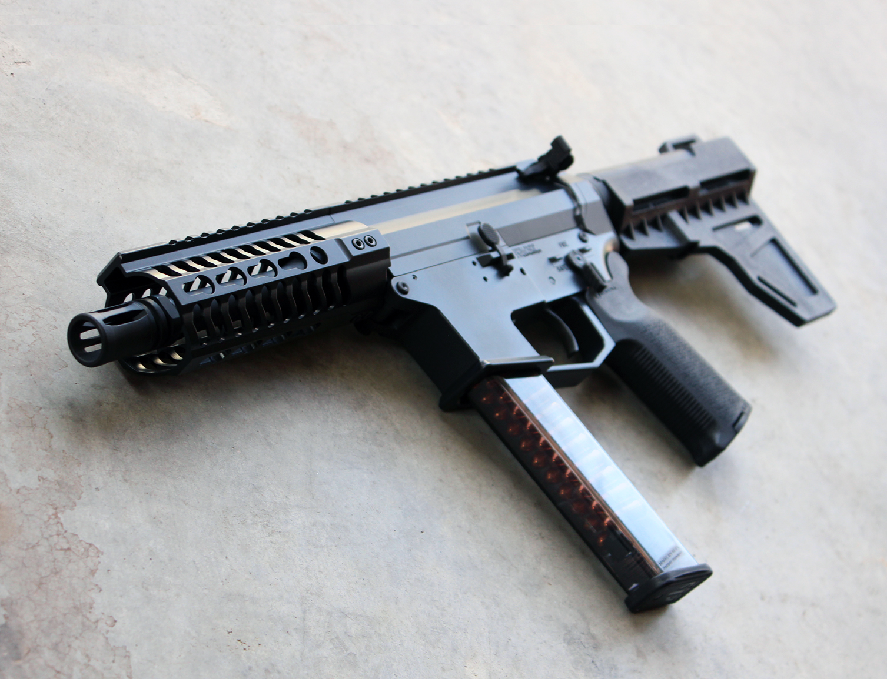
THE STAR SERIES
The STAR is a compact Sub Machine Gun that comes in two main calibers both 9MM and .45 ACP.
This unique allows the use of STD Glock Magazine that are highly common and comes in a verity of Magazine capacity.
It’s a light weight Sub Machine Gun (less than 2 Kg) fires at a rate of 1200-1400 RPM.
This gives the possibility to shoot a sub sonic Ammunition and HP along FMJ of course.

Slide 6
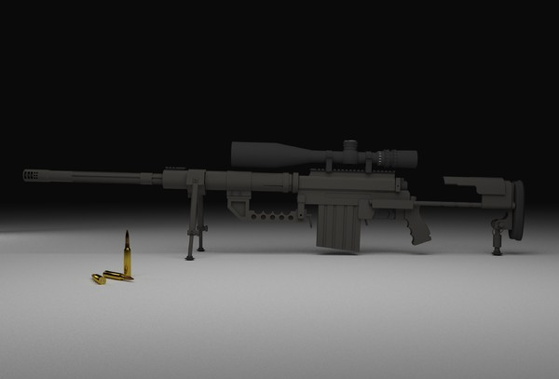
SNIPER RIFLE THE XDL
The XDL 408 Cheytac is one of our main prides. It presents a highly performed long range Sniper rifle that hold accuracy up to 2500-3000 meters!
Specifications:
•Action Type: CheyTac Long Action w/40 MOA Base
•Effective Range: 2500 Yards
•Caliber: .408 or .375 CheyTac®
•Overall Length: 56 inches
•Interchangeable Barrels:
29” .408 Cal Twist 1:13.25
29” .375 Cal Twist 1:11.25
•Weight: approx. 29 lbs
•Stock: retractable

Slide 7
50 BMG anti-matEriAl rifle
Options: -735mm or 910mm barrel length -Custom/alternate finish -Spare Magazine {mil spec arrives with 3 magazines } Features:•Durable mil-spec design and construction •Unique barrel recoil technology dissipates most recoil energy •Semi automatic design •Magazine fed for ease of reloading •Bullpup design for compact size and optimum weight distribution •Sub-MOA with match grade ammunition Specifications: Caliber: .50 BMG Effective Range: 1500m Magazine Capacity: 5 Method of Operation: Long Recoil Action Operating Length: 1126mm Transportation Length: 928mm Barrel Length: 730mm/910mm Weight, Empty: 11500g

Slide 8
"Judgment" long range sniper system 338
Judgment –STARMIS Long Range Tactical
.338 Lapua Magnum
26" Fluted blackened stainless varmint contour barrel
Blackened Stainless receiver, drilled and tapped
AAC Muzzle Brake / Detachable suppresser
Detachable Magazine {7 rounds}
Steel trigger guard / Hair trigger 2.8Lbi
Adjustable recoil pad
Effective range 1100-1400 meter with proper ammo

Slide 9
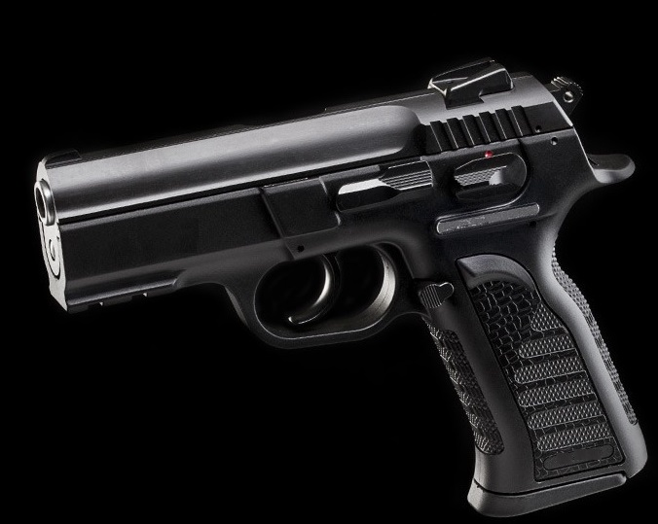
Pistols – golani series
The GOLANI series are the winning pistol design. Reliability, ruggedness, accuracy, and ease of use are all features that a combat operative or a law enforcement looks for in his service hand gun. And that is what the GOLANI gives.
The GOLANI comes in several versions a Full Size pistol, a Compact one and also, a Sub Compact pistol. It also chambered in several calibers such as 9mm, .40SW, .45 ACP etc.
There are also a big verity of accessories that can come with it as well.

Slide 10
Ammunition
As to Ammunition, we in STARMIS ARMS Inc., can provide almost anything out there.
We know and already have been providing our clients on an ongoing monthly shipments, a large verity: 9X19,9X18, 45 ACP, 556 NATO, 762X39, 762X45, 762X51, 762X54, 408 CHEYTAC, 20MM, 23MM, etc.
We also have the ability to establish a manufacturing ammunition line at your facility.

Slide 11
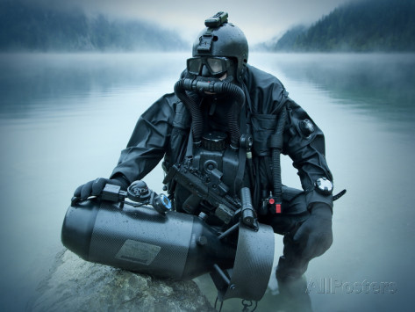
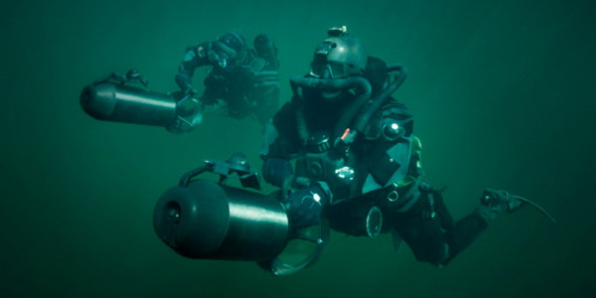
MILITARY DIVING
Military diving is the name for a wide area of combat, intelligence tasks, border defense tasks, demolition tasks etc.
We in Starmis Arms Inc., have the abilities to provide a large range of equipment for a squad or individual warrior.

Slide 12
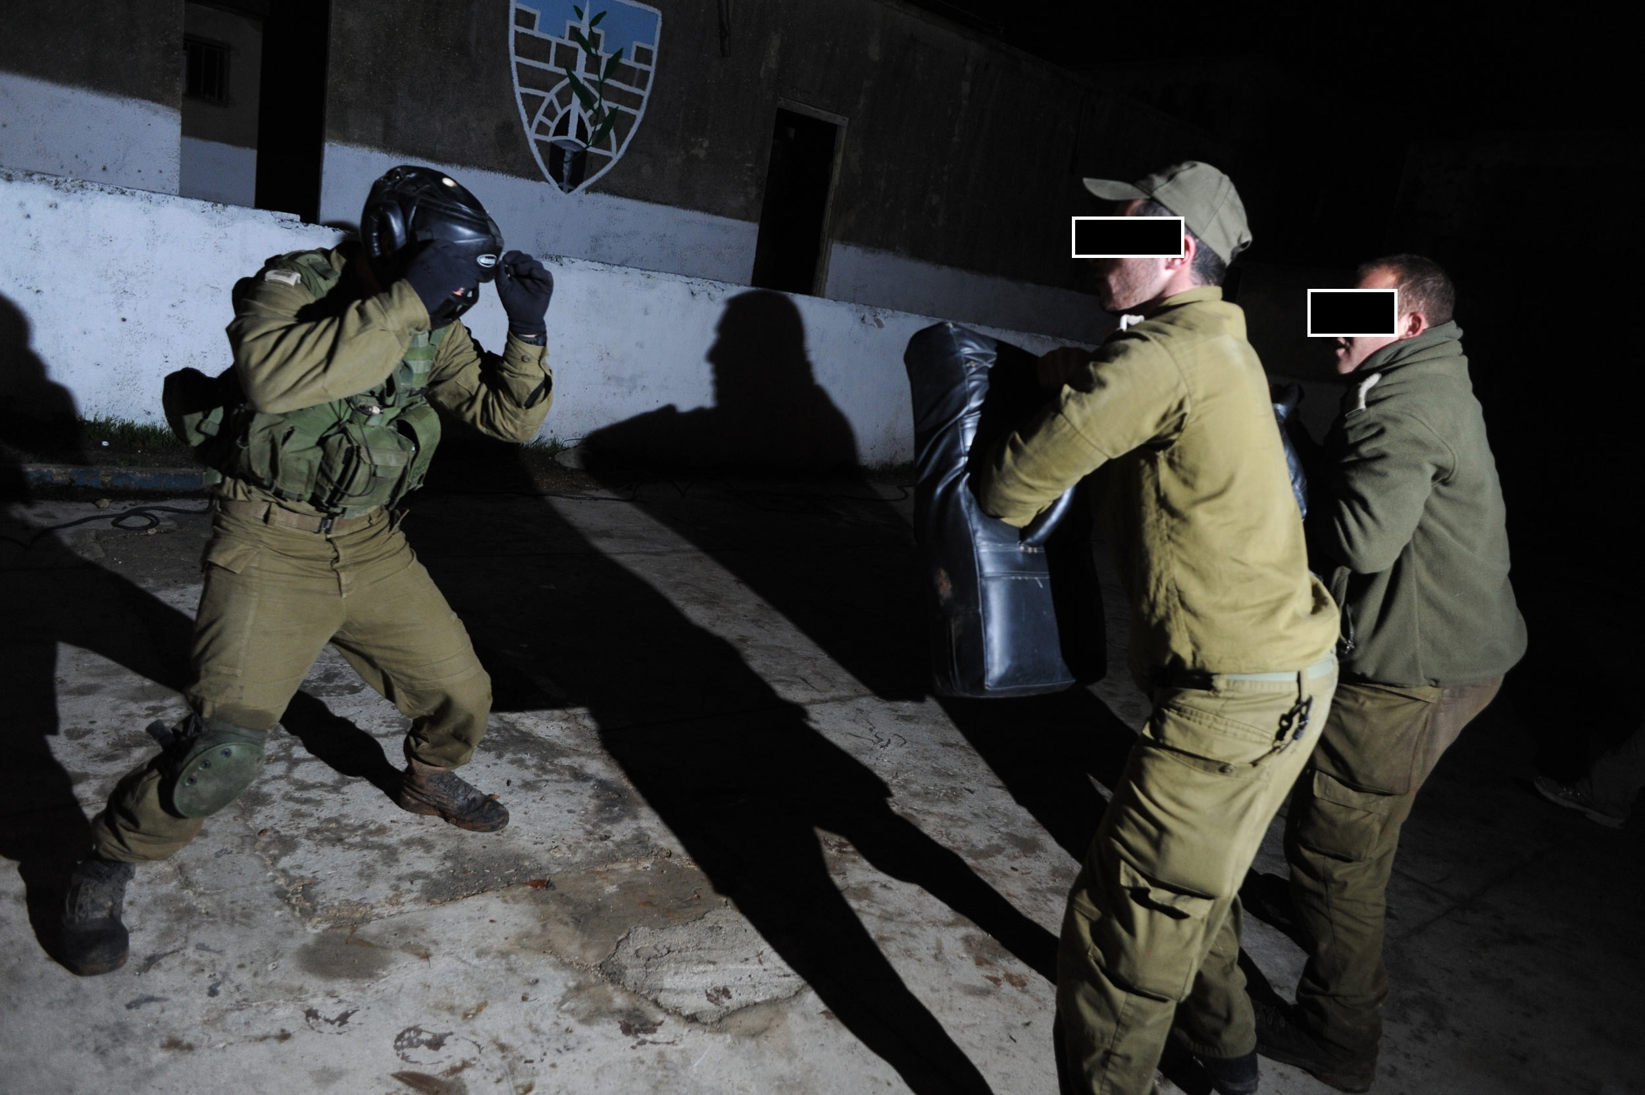
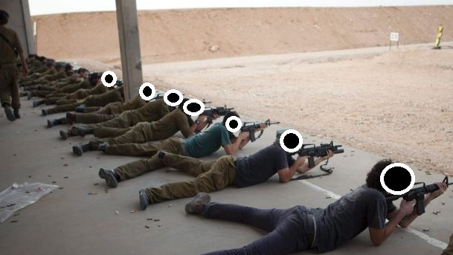
Starmis arms Inc. training
One of the most important things we are providing is training courses, we do that for a massive range:
Snipers.
Divers.
Parachuting.
Border patrol.
Explosives Disposal.

Slide 13
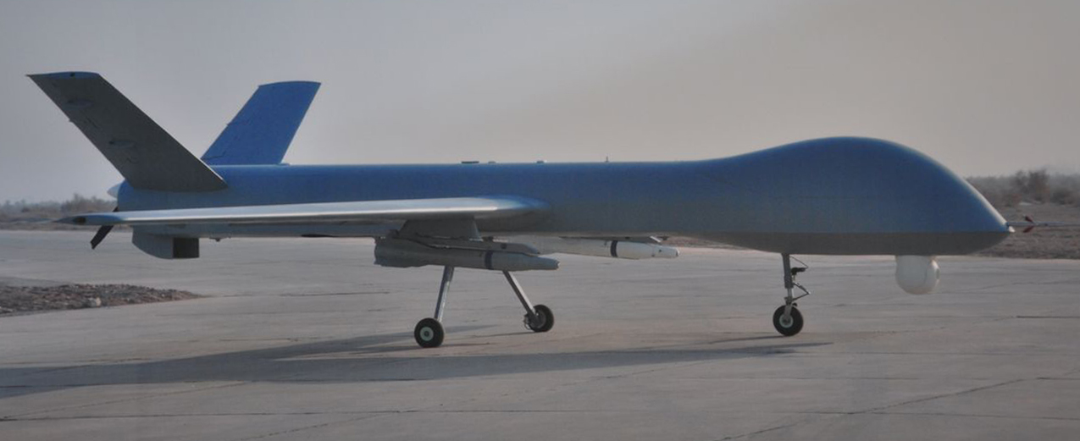
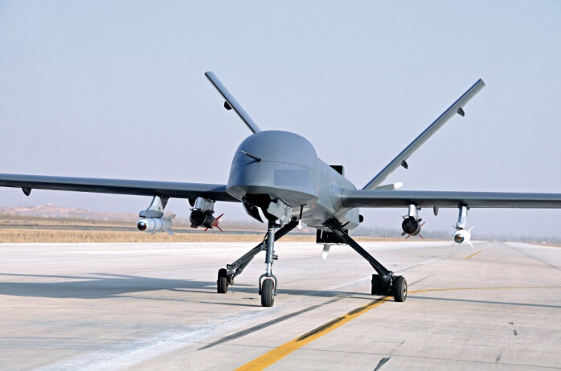
Drones
Military Drones are aircrafts that are usually armed. These aircrafts have no onboard human pilot. Military Drones were used for various civilian operations such as search and rescue, weather analysis, etc. They are known for their “precision” and “stealth” features. Drones have carried out monumental tasks in preventing terrorist attacks. In recent years, the drones are now used for:
the war on terrorism, spying, surveillance tasks, save lives etc.
In general, Drones are as lethal as to the enemy as regular airplanes.

Slide 14
As you can see, we have the sources and abilities to accomplish and supply almost any demand you have IF ITS WEAPONS, AMMUNITION OR MILITARY EQUIPMENT.
Thank you for this opportunity and its our pleasure to do business with you!
STARMIS ARMS INC.

